Slide 1

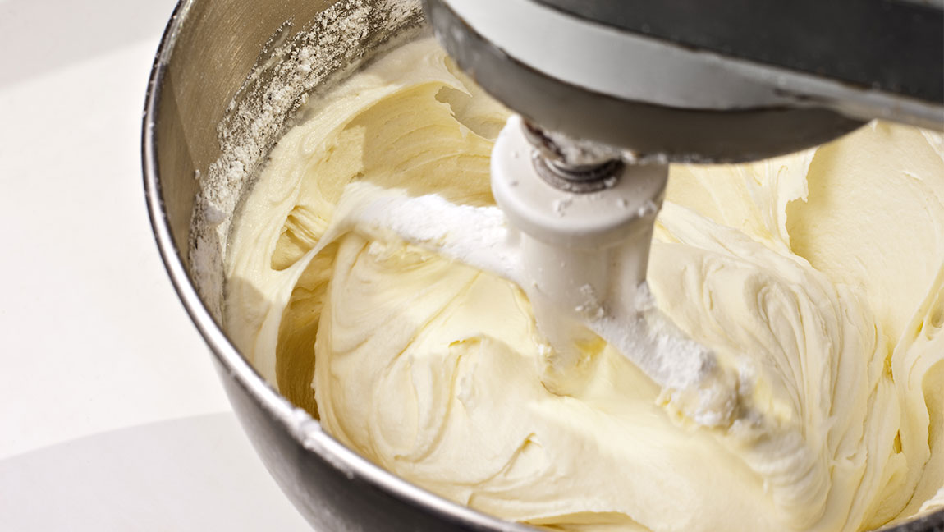
Butter cream with S17
Fondant powder S17
PREPARATION
Beat to softened butter
Add fondant powder
Blend the mixture.
Add aroma of your choice
INGREDIENTS
500gr butter
300gr S17
Aroma

